Slide 1
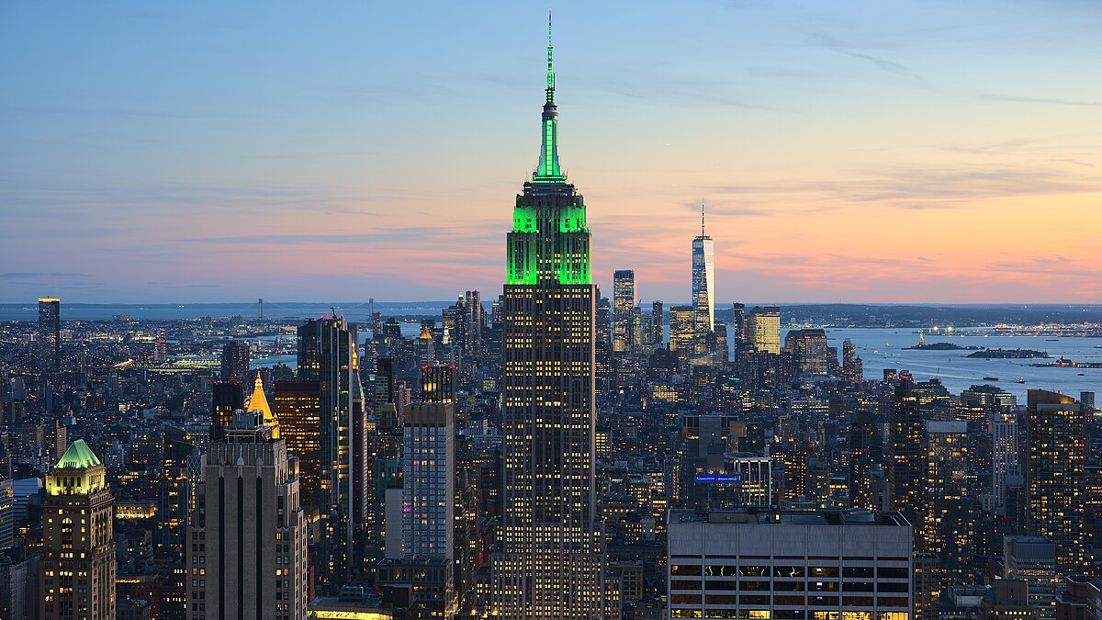
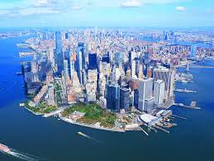
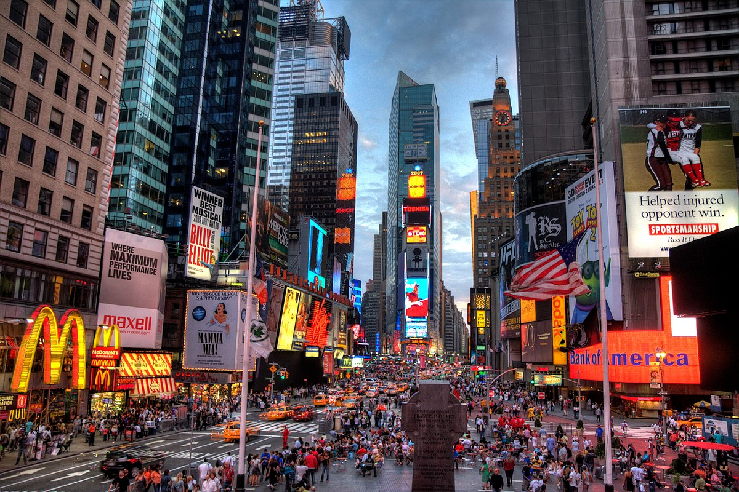
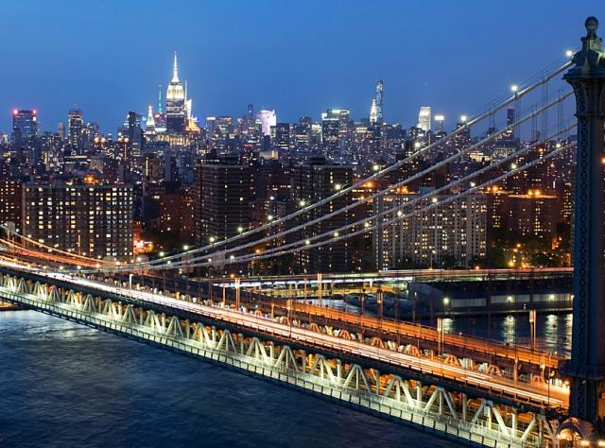
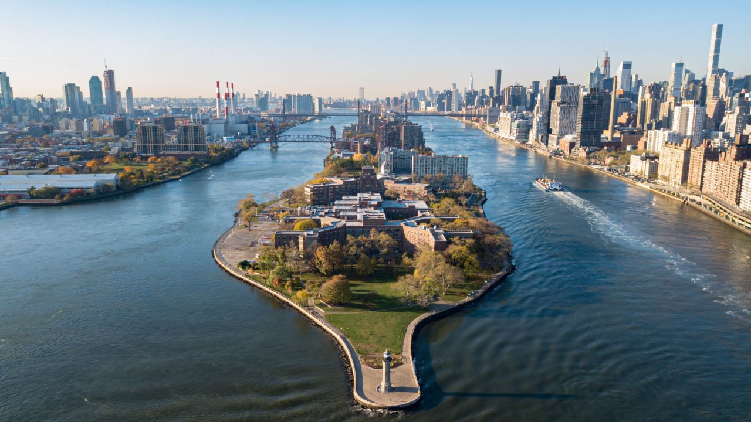
NEW YORK

Slide 2
NEW YORK
TEXT TEXT TEXT TEXT TEXT
TEXT
TEXT
TEXT

Slide 3
NEW YORK
TEXT TEXT TEXT TEXT TEXT
TEXT
TEXT
TEXT

Slide 4
NEW YORK
TEXT TEXT TEXT TEXT TEXT
TEXT
TEXT
TEXT

